Slide 1
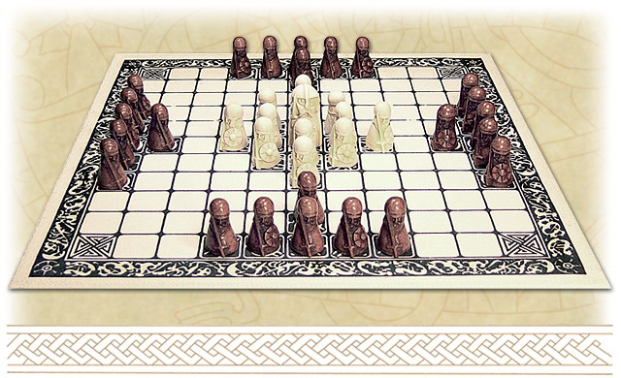
Hnefatafl
Project 1: Requirements Analysis (Group CAACC)

Slide 2
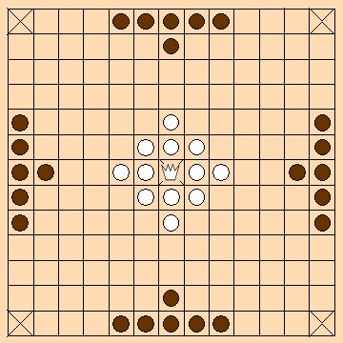
Use Cases

Slide 3
Use Case: Registering to System
Level: user goal
Primary Actor: player
Stakeholders and Interests:
- Player: Would like to register to system in order to play games with other registered users. Would like process to be quick, with minimal information required to enter.
Preconditions: Player has a valid email with which to register
Postconditions: Player is registered with system. Email + password combination can be used by player to log back into the system. Nickname entered has saved correctly.

Slide 4
Register to System (cont.)
Basic Flow:
1. Player arrives at registration screen to register for system.
2. Player enters a unique email, password, and nickname to identify his/herself.
3. Registration is successful and player is able to create games, join games, etc.
4. At any point after, the player may access the system again by entering previous credentials.

Slide 5
Register to System (cont.)
Special Requirements:
- Connecting to server should be a relatively quick experience, exact time TBD
Frequency of Occurrence:
- Several ( > 10, < 100) times per hour
Open Issues:
-Should we check for good passwords, or allow users the freedom to choose any (potentially bad passwords?
- Any lock-out type mechanism if a user fails a password multiple times in a row?

Slide 6
Use Case: Invite another user
Scope: Hnefatafl Game
Primary Actor: Player
Stakeholders and Interests:
Player: Wants to be able to send an invitation to another player and launch a game.
Preconditions: Player One wanting to invite Player Two knows some information about Player Two as means to connect the two.
Success Guarantee: Both players wishing to play together are connected in a game.

Slide 7
Invite another user (cont.)
Basic Flow:
1. A player sends an invite to another player
2. The invitee receives the invite and can either accept or decline.
3. The invitee accepts the invite
4. Both players join a game together.

Slide 8
Invite another user (cont.)
Extensions:
3.a The invitee declines the invite.
Neither player joins a game.
Player sending the invite is notified of the decline.

Slide 9
Use Case: Quit a game
Scope: Hnefatafl Game Primary Actor: Player Stakeholders and Interests: Player: Wants to be able to quit a game of Hnefatafl at any time. Preconditions: The player must be in a game of Hnefatafl with 0 or 1 other players. Success Guarantee: The player is no longer in the game of Hnefatafl. The history of the player is updated.

Slide 10
Quit a game (cont.)
Main Success Scenario: 1. Player is in a game of Hnefatafl. 2. The player can open the menu and click ‘quit’ the game. 3. The player is removed from the current game of Hnefatafl. 4. The players game history is updated. 5. The lobby will present a win to the remaining player

Slide 11
Quit a game (cont.)
Extensions: 1. At any time the player may close the game client. a. The player force-quits the game application b. That player is removed from the current game of Hnefatafl. c. That players game history is updated. d. The lobby will present a win to the remaining player

Slide 12
Use Case: Unregister
Scope: Hnefatafl Game Primary Actor: Player Stakeholders and Interests: Player: Wants to be able to unregister from the game client at any time.
Preconditions: The player must have a valid registered account on the game client.
Success Guarantee: The player’s account is no longer registered to the game client. The player’s profile/nickname/history/email are deleted from the system. The player’s profile is no longer visible to other users.

Slide 13
Unregister (cont.)
Main Success Scenario: 1. Player has a registered account on the game client. 2. The player can click ‘unregister’ from the main menu. 3. The player’s account is no longer registered to the game client. 4. The player’s account information is deleted from the system and is now available for re-use 5. The player’s account is no longer visible to other users. 6. The game client will exit, and display the login screen.

Slide 14
Use Case: Player History
Scope: Hnefatafl Game
Primary Actor: System
Stakeholders and Interests:
Player: Wants to be able to view a history of played matches and information relating to them.
Preconditions: The Player must have played 1 or more games.
Success Guarantee: System contains data relating to the played matches that is accessible to the player.

Slide 15
Player History (cont.)
Main Success Scenario:
Player begins a game of Hnefatafl.
Player leaves said game, by any means.
Game history is saved by the system.

Slide 16
Use Case: View Profile
Scope: Hnefatafl Game Primary Actor: Player Stakeholders and Interests: Player: Wants to be able to see their profile and track information about their games.
Preconditions: User has created a profile.
Success Guarantee: Player is able to view their profile and information about the games they have played.

Slide 17
View Profile (cont.)
Main Success Scenario:
1. Player creates their profile
2. Player plays a game or many
3. A Player requesting access to their profile is granted by the system to view.

Slide 18
Use Case: Play the Game
Scope: Hnefatafl Game
Primary Actor: Player
Stakeholders and Interests:
Player: Wants to play a responsive, intuitive implementation on Hnefatafl.
Preconditions: 2 players have joined the game, the host has started the game.
Success Guarantee: The king piece reaches a corner square or The king piece is captured.

Slide 19
Play the Game (cont.)
Main Success Scenario: 1. System grants the attacking player the first turn.
2. On their turn, a player moves one of their pieces.
3. The system grants a turn to the other player.
Steps 2-3 are repeated until a victory state is achieved
4. The King piece reaches a corner square.
5. A victory is granted to the defending player.
6. A loss is granted to the attacking player.

Slide 20
Play the Game (cont.)
Extensions: 4.a The King piece is captured.
1. A victory is granted to the attacking player.
2. A loss is granted to the defending player.
*.b At any time, a player disconnects from the game.
1. A victory is granted to the remaining player.

Slide 21
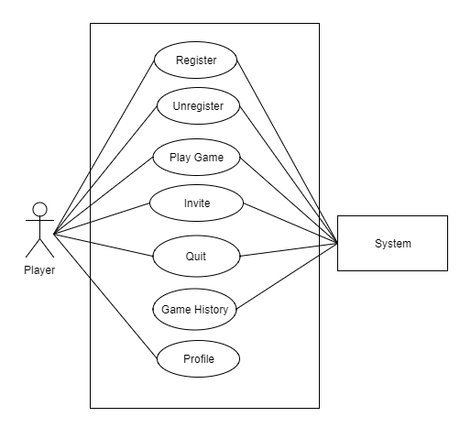
Use case diagram

